Slide 1
Binary Classification

Slide 2
Binary or binomial classification is the task of classifying the elements of a given set into two groups on the basis of a Classification rule.
Some typical binary classification tasks are
medical testing to determine if a patient has certain disease or not (the classification property is the presence of the disease)
quality control in factories; i.e. deciding if a new product is good enough to be sold, or if it should be discarded (the classification property is being good enough)

Slide 3
Introduction
Statistical classification in general is one of the problems studied in computer science.
Some methods suitable for learning binary classifiers include the decision trees, Bayesian networks, support vector machines, neural networks, probit regression, and logit regression.
Sometimes, classification tasks are trivial. Given 100 balls, some of them red and some blue, a human with normal color vision can easily separate them into red ones and blue ones.

Slide 4
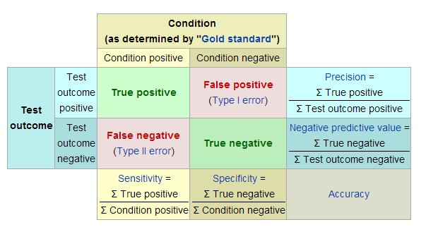
Confusion Matrix

Slide 5
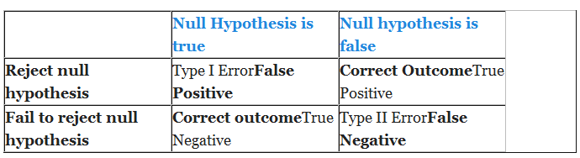

Slide 6
Sensitivity and Specificity
Sensitivity and specificity are statistical measures of the performance of a binary classification test, also known in statistics as classification function.
Sensitivity (also called the true positive rate, or the recall rate in some fields) measures the proportion of actual positives which are correctly identified as such (e.g. the percentage of sick people who are correctly identified as having the condition).
Specificity (sometimes called the true negative rate) measures the proportion of negatives which are correctly identified as such (e.g. the percentage of healthy people who are correctly identified as not having the condition). These two measures are closely related to the concepts of type I and type II errors.

Slide 7

K-Nearest Neighbor
Classifier

Slide 8
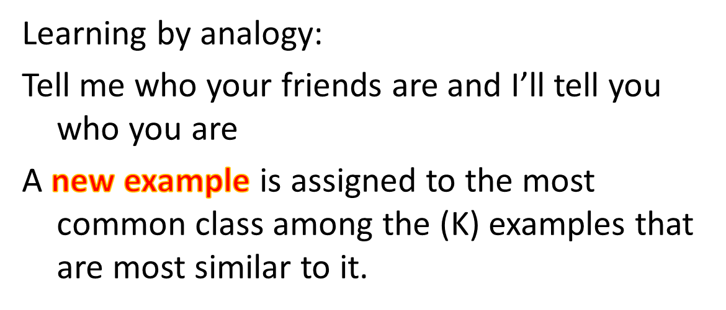




K-Nearest Neighbor Classifiers

Slide 9






K-Nearest Neighbor Algorithm
To determine the class of a new example E:
  Calculate the distance between E and all examples in the training set
  Select K-nearest examples to E in the training set
  Assign E to the most common class among its K-nearest neighbors
Response
No response
No response
Class: Response
No response
Response

Slide 10
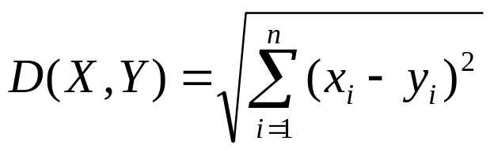
K-Nearest Neighbor Classifier
Distance Between Neighbors
Each example is represented with a set of numerical attributes
“Closeness” is defined in terms of the Euclidean distance between two examples.
  The Euclidean distance between X=(x₁, x₂, x₃,…x_{n}) and Y =(y₁,y₂, y₃,…y_{n}) is defined as:
  Distance (John, Rachel)=sqrt [(35-41)²+(95K-215K)² +(3-2)²]
  John:
  Age=35
  Income=95K
  No. of credit cards=3
  Rachel:
  Age=41
  Income=215K
  No. of credit cards=2

Slide 11
K-Nearest Neighbor: Instance Based Learning
No model is built: Store all training examples
Any processing is delayed until a new instance must be classified.
Response
No response
No response
Class: Respond
No response
Response

Slide 12
Example : Nearest Neighbors
K-Nearest Neighbor Classifier
Customer | Age | Income | No. credit cards | Response
John | 35 | 35K | 3 | No
Rachel | 22 | 50K | 2 | Yes
Hannah | 63 | 200K | 1 | No
Tom | 59 | 170K | 1 | No
Nellie | 25 | 40K | 4 | Yes
David | 37 | 50K | 2 | ?

Slide 13
K-Nearest Neighbor Classifier
Example
Customer | Age | Income (K) | No. cards
John | 35 | 35 | 3
Rachel | 22 | 50 | 2
Hannah | 63 | 200 | 1
Tom | 59 | 170 | 1
Nellie | 25 | 40 | 4
David | 37 | 50 | 2
Response
No
Yes
No
No
Yes
Distance from David
sqrt [(35-37)²+(35-50)² +(3-2)²]=15.16
sqrt [(22-37)²+(50-50)² +(2-2)²]=15
sqrt [(63-37)²+(200-50)² +(1-2)²]=152.23
sqrt [(59-37)²+(170-50)² +(1-2)²]=122
sqrt [(25-37)²+(40-50)² +(4-2)²]=15.74
Yes

Slide 14
K-Nearest Neighbor Classifier
Strengths and Weaknesses
Strengths:
Simple to implement and use
Comprehensible – easy to explain prediction
Robust to noisy data by averaging k-nearest neighbors.
Some appealing applications
Weaknesses:
Need a lot of space to store all examples.
Takes more time to classify a new example than with a model (need to calculate and compare distance from new example to all other examples).

